Slide 1
Bovée and Thill Business Communication Hall of Fame
Minimalist Design at Fear No Project blog

Slide 2
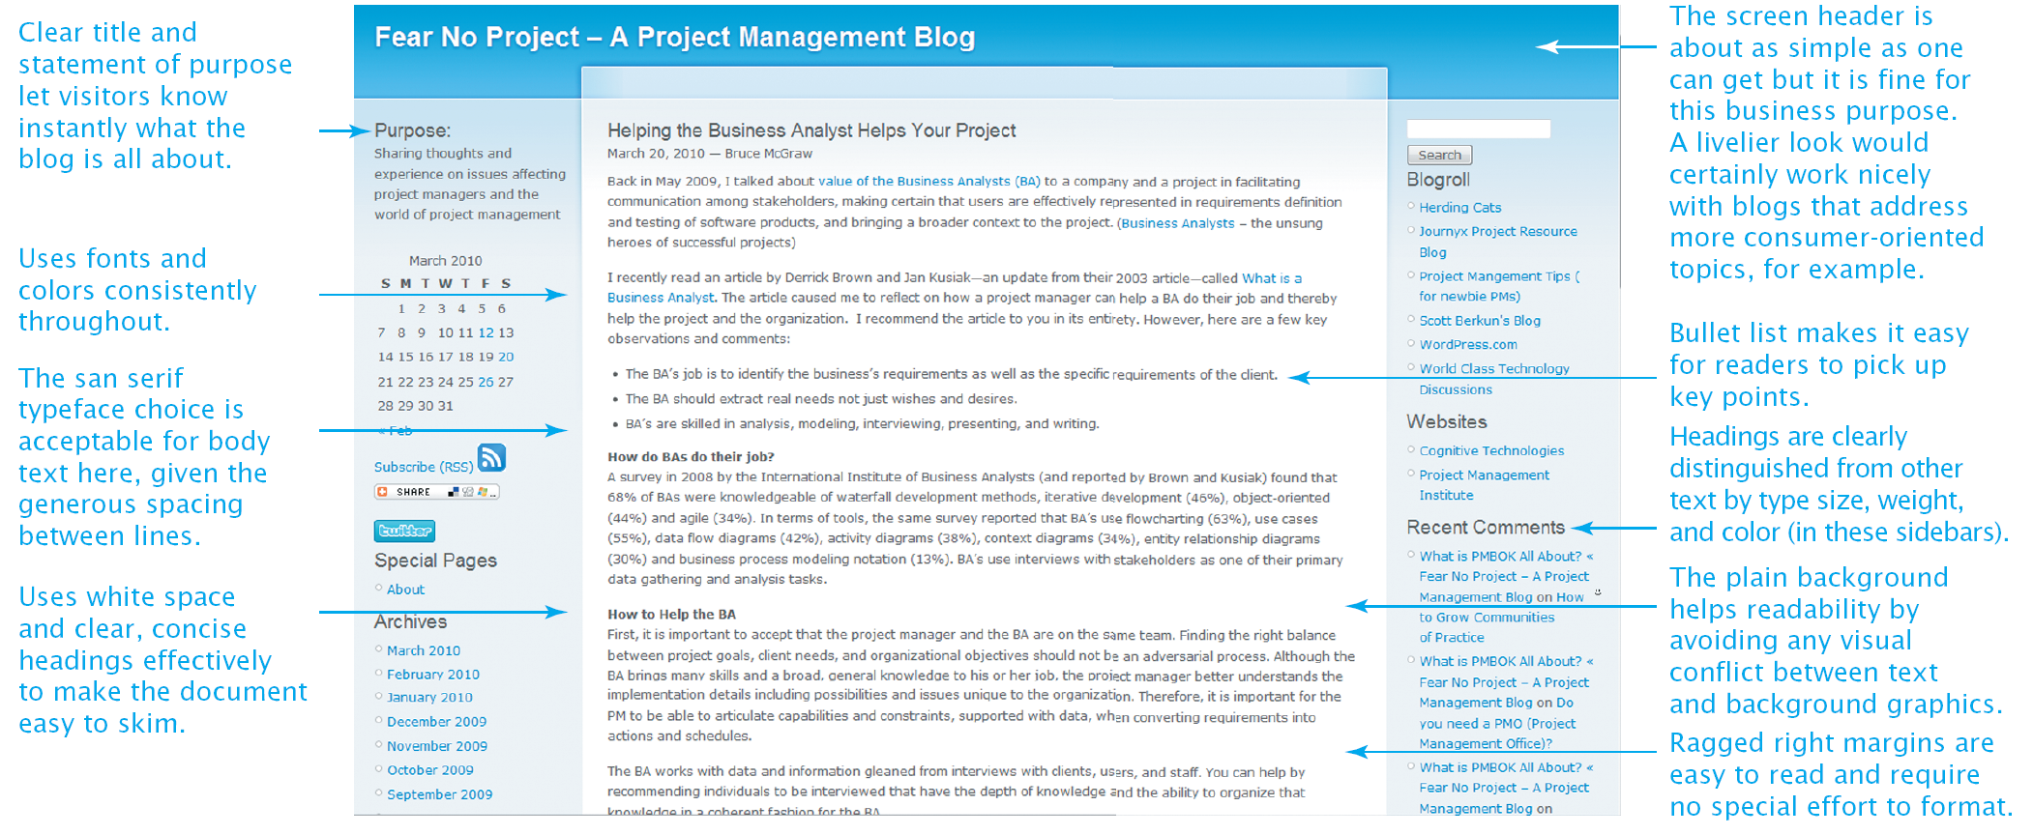
Clear purpose, clean design: nothing gets in the way

