Slide 1
Bovée and Thill Business Communication Hall of Fame
Effective webpage design at TD Ameritrade

Slide 2
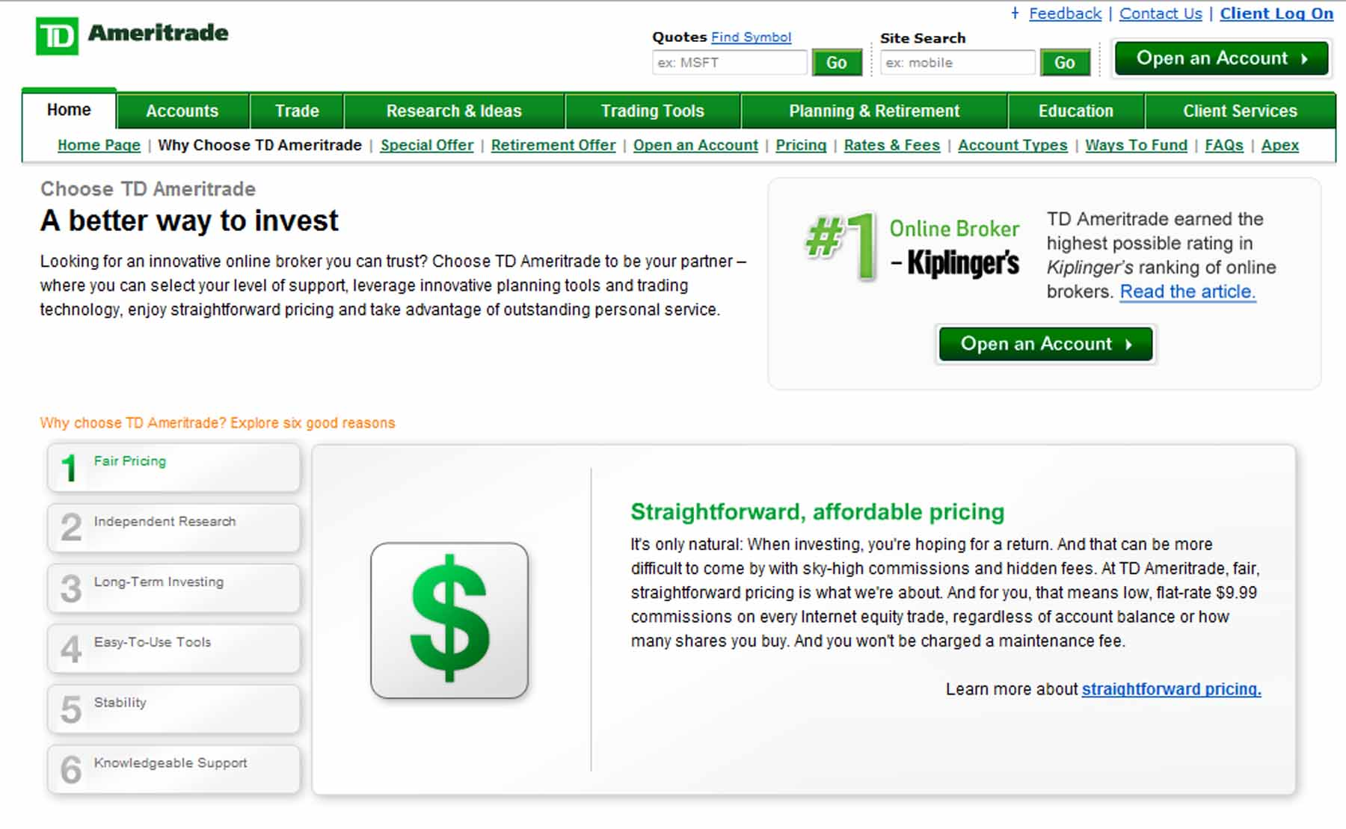
TD Ameritrade: Aligning form with function
Notes:
On this expertly written and designed webpage, TD Ameritrade echoes back the concerns that individual investors are likely to have when selecting a stockbroker. Notice how well the writing moves the reader from the high-level message to six individual supporting points—each of which is a major audience need—and then on to more detailed information. The clean, focused design is equally effective and works in close harmony with the text. The layout guides the reader’s eye from the upper left corner, downward to the six key support points, and then across to the right for additional layers of detail. If the eye follows this circular flow, it ends up in the single “hotspot” on the screen, the Kiplinger’s endorsement/call to action block.

Slide 3
TD Ameritrade: Aligning form with function
The main idea of “choose TD Ameritrade” is echoed from the webpage tab, through the introductory text, and down to the specific details.
Notes:
The choose-choose-choose repetition flows naturally down the left side of the screen.

Slide 4
TD Ameritrade: Aligning form with function
The headline and introductory paragraph address universal concerns among investors.
Notes:
Along the way down the page, readers encounter a short headline with promotional promise and a brief paragraph that starts to pay off that promise.

Slide 5
TD Ameritrade: Aligning form with function
These six supporting points—each of which reflects a key audience need—back up the top-level message of “A better way to invest.”
Notes:
The six supporting points provide the next level of proof to support the high-level message

Slide 6
TD Ameritrade: Aligning form with function
Each of the six supporting points is presented at four levels of detail:
The short message of the button labels at the far left
The simple visual icon
A short paragraph with a headline that echoes the audience need
Additional pages with full details
Notes:
For each of the six points, the page flows naturally across, from the labeled link to the short subheading and its accompanying detail paragraph and on to a link that provides the final level of detail.

Slide 7
TD Ameritrade: Aligning form with function
The down-then-across flow wraps around this single “hotspot,” an endorsement from a well-known source that boosts the credibility of the company’s promotional message.
Notes:
Unlike many webpages that hit visitors with multiple visual hotspots that pull the eye back and forth, this screen has a single dominant grabber that doesn’t impede the main messaging flow. The reader’s attention might get pulled over there momentarily, but it’s easy to absorb that endorsement message and then continue with the main flow of the page.
The hotspot also works well as a concluding call-to-action (“Open an Account”) for visitors who’ve followed the circular flow and read enough to be convinced.

Slide 8
TD Ameritrade: Aligning form with function
Notes:
The circular flow from top left corner, down the left side, across to the bottom right corner and then up to the hotspot takes the reader from the high-level message, through the support points at successive level of detail and delivers them directly to the call the action.
Whether the reader’s eye is grabbed first by the “A better way to invest” headline or the “#1” endorsement hotspot and then moves over to the headline, this webpage is also a great example of the “AIDA” model in action: get their attention, build interest with some intriguing claims, increase desire by supporting those claims, and then ask for a decision.

