Slide 1
Bovée and Thill Business Communication Hall of Fame
Creative Commons website

Slide 2
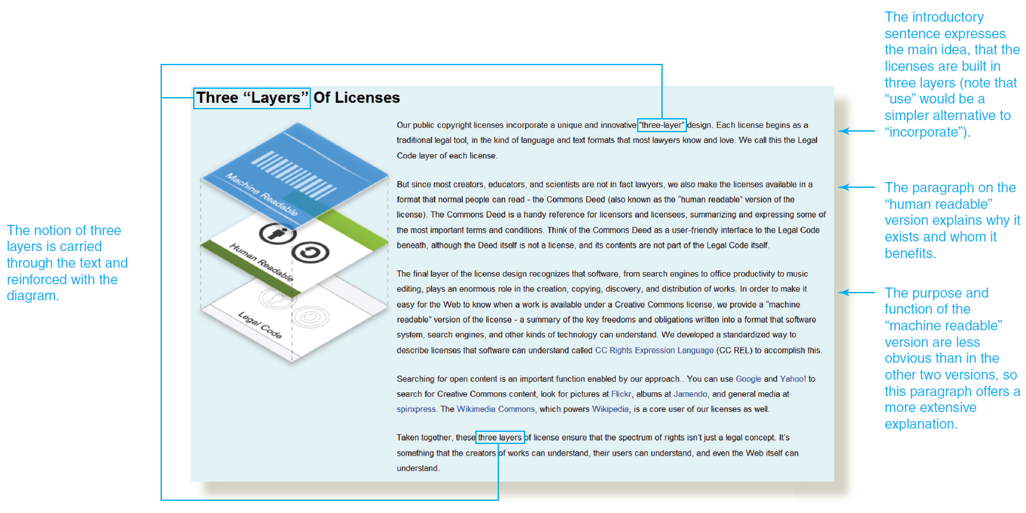
CC website: Using plain language to explain technical and legal details

