Slide 1
Bovée and Thill Business Communication Hall of Fame
Communicating Negative News at Hailo

Slide 2
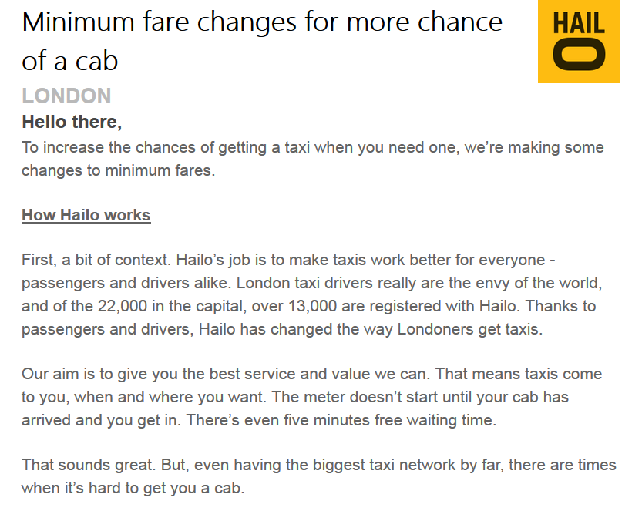
Sharing unwelcome news: explain and put in a positive context
Starts right off with a reader benefit, then hints at news to come
Prepares the reader for the negative news about minimum fare hikes by reminding readers how the Hailo system works.

Slide 3
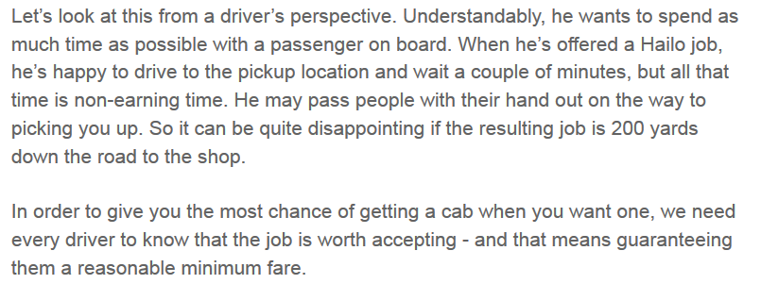
Sharing unwelcome news (continued)
The rest of the explanation: If we all want a better chance of getting a cab, we need to make it worth the driver’s time.

Slide 4
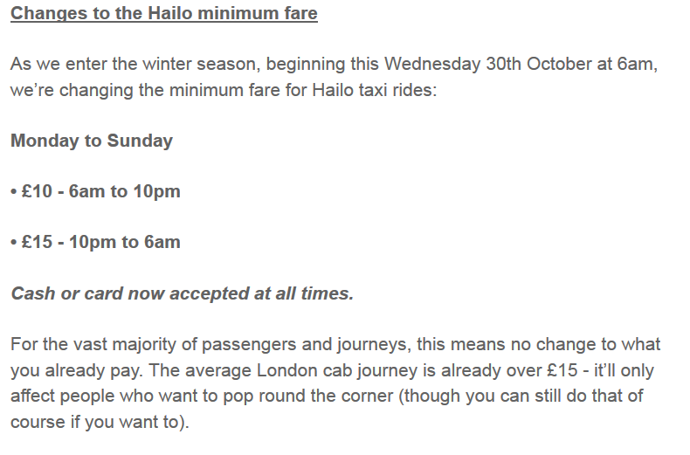
Sharing unwelcome news (continued)
With the reasoning in place, the message moves on to deliver the unwelcome news about increases in the minimum fare during peak hours.
Ends on a positive note by pointing out that the increase won’t affect the majority of customers.

