Slide 1
Bovée and Thill Business Communication Hall of Fame
Red Ants Pants communicates with a personal touch

Slide 2
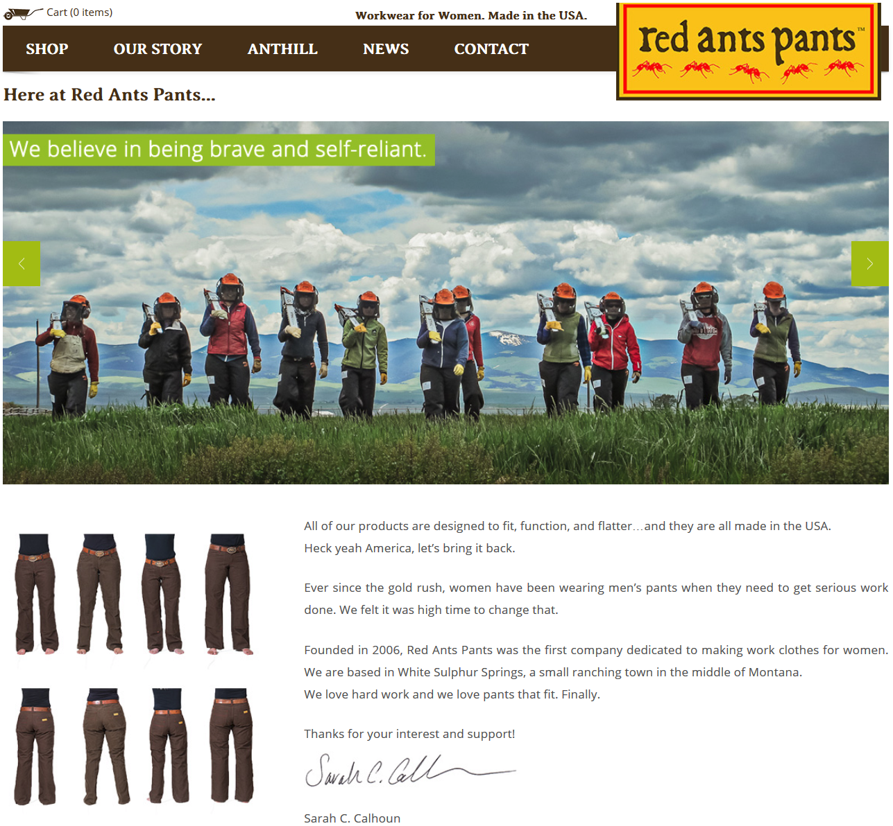
Red Ants Pants: Business communication with a personal touch
Red Ants Pants makes tough work pants for women.
The company’s communication efforts all sound as though founder Sarah Calhoun is talking to you over coffee or giving a rousing motivational speech.

Slide 3
Company history as rhyming couplets
Not many companies could pull this off without looking foolish.
The poem tells the story of how Calhoun grew frustrated with the lack of hard-wearing pants for hard-working women—a frustration that led her to launch Red Ants Pants.

